Slide 1
Employee Data Analysis using Excel
STUDENT NAME: S. PRIYADARSHINI
REGISTER NO: 172722
DEPARTMENT: B.COM (COMPUTER APPLICATION)
COLLEGE : PACHAIYAPPAS COLLEGE FOR WOMEN

Slide 2
PROJECT TITLE
Creating An Employee
Performance Scorecard

Slide 3


AGENDA
Employee Scorecard
What's an employee scorecard?
Who uses employee scorecards?
Benefits of an employee scorecard
Our solution and its value proposition
Objective
Result
Results and Discussion
Conclusion
3/21/2024 Annual Review

Slide 4

Employee Scorecard
Many corporate spaces used to struggle with employee productivity. And most employees were either unsatisfied, lacked motivation, or both. This changed with the invention of the scorecard.
Since its introduction in the late 1990s, many companies have reported increased performance and lower employee turnover rates. It's a dynamic tool that can be used on a large scale and customized for individual employees.
Not only that, but the scorecard also encourages self-development. Join us as we take you through an in-depth review of employee scorecards, their benefits, and how to create one. As a bonus, we've also included employee scorecard examples.

Slide 5

What's an employee scorecard?
An employee scorecard is a management tool used to monitor an employee's performance. It's the perfect organizational tool because it allows individuals to plan, prioritize, and implement required projects.
It outlines every individual's role and contribution to the workplace.
Plus, it allows people to focus on their roles, thereby improving their productivity. An employee scorecard also contributes to employee well-being (through clarity and affirmation) and encourages self-development.

Slide 6

Who uses employee scorecards?
Higher learning institutions
Governments
Manufacturing
Telecommunications
Information technology
Banks

Slide 7

OUR SOLUTION AND ITS VALUE PROPOSITION
Data-Driven Insights: Enables managers to make informed decisions based on accurate, real-time performance data.
Improved Efficiency: Automates the data collection and analysis process, saving time and reducing manual errors.
Enhanced Employee Development: Identifies training needs and development opportunities, leading to a more skilled workforce.
Better Performance Management: Helps in recognizing top performers and addressing underperformance, ultimately improving overall productivity.
Cost-Effective Solution: Leverages the widely accessible Excel platform, avoiding the need for expensive software or tools.

Slide 8
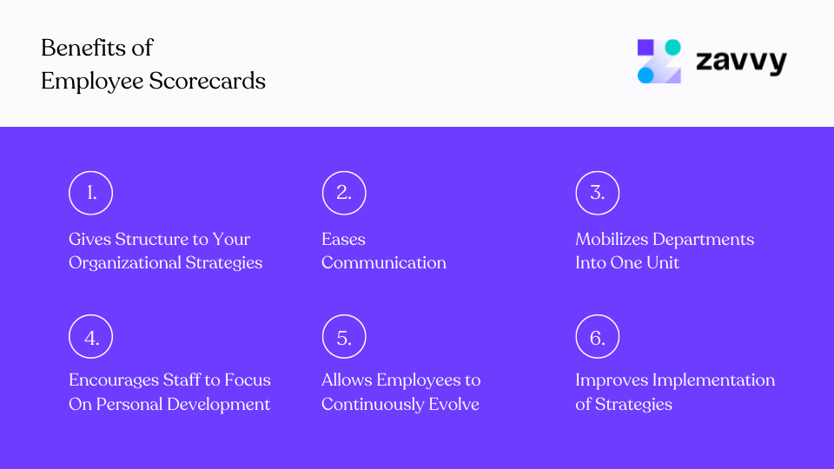
🏆 Benefits of an employee scorecard

Slide 9
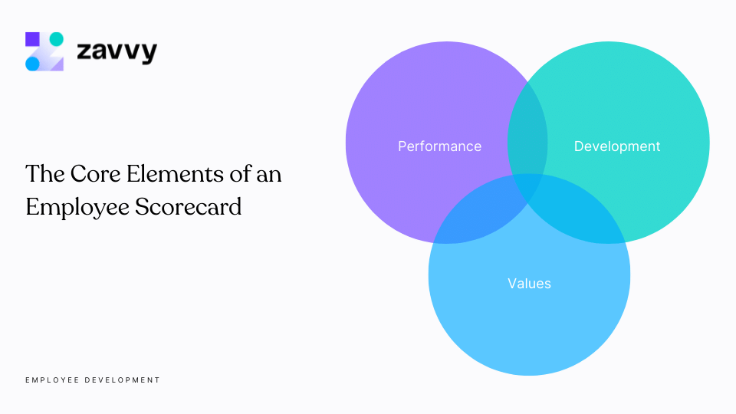
🗂️ What should be on an employee scorecard?

Slide 10

Objectives
These are the goals that the individual is working towards.
Strategic map
An employee scorecard should contain an overview of your business goals and objectives. This overview is known as a strategy map. It's beneficial during the planning and execution of a company's policies. Your strategy map should contain four crucial perspectives
3/21/2024 Annual Review
10

Slide 11
Result

Slide 12
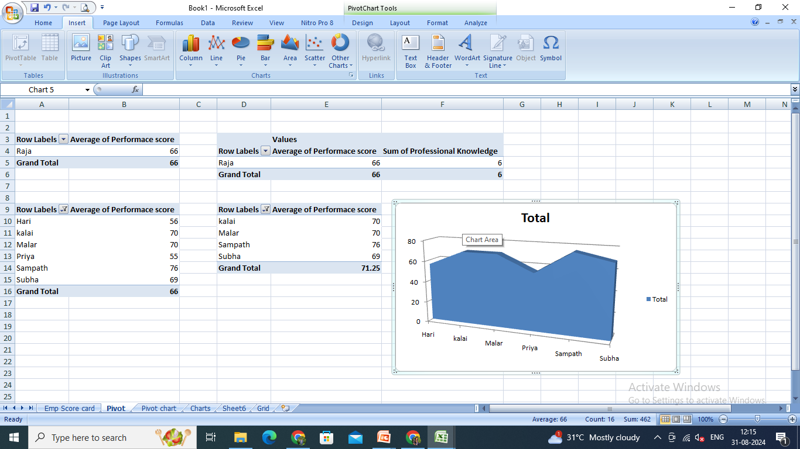
EMPLOYEE PERFOEMANCE RATING PIVOT TABLE

Slide 13
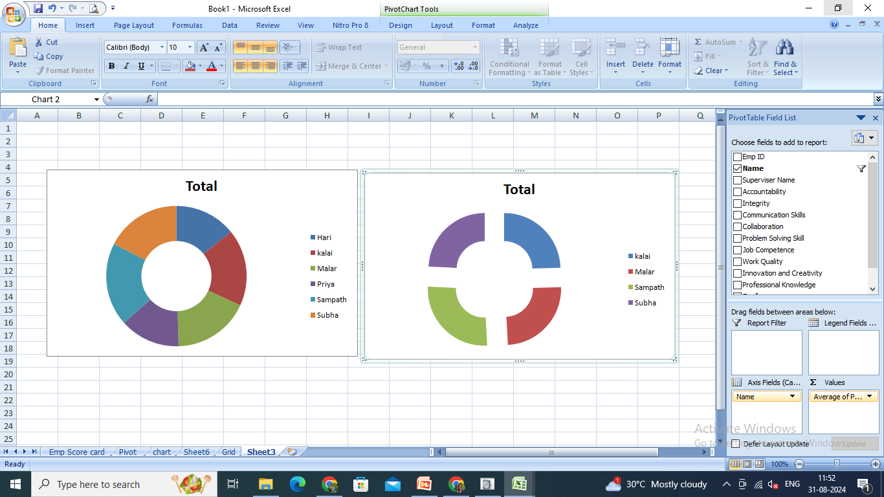
EMPLOYEE PERFOEMANCE RATING CARD AND DASHBOARD

Slide 14
Results and Discussion
An employee scorecard is perfect for improving performance in the workplace. It's a multifaceted tool that not only boosts productivity but also encourages self-development.
Creating a KPI scorecard doesn't have to be hard:
Set up interviews to get what to include.
Make a list of strategic goals and metrics you'd like to achieve. Include performance, development, and values.
You can have your scorecard in various formats, including PDF and Excel. But stick to one.
You'll also need an action plan for goal tracking. Lastly, evaluate your progress frequently to make sure you stay on track. I recommend setting up scorecards for your workplace today for improved performance.

Slide 15
conclusion
An Excel-based Employee Performance Rating Card and Dashboard is very useful and adaptable tool. It can significantly enhance your performance management process.

Slide 16


